Slide 1
Java I/O Basics
Objective: Use the built-in Java I/O libraries to perform input and output functions on the console and files.

Slide 2
Streams
Streams are the method Java uses when inputting and outputting data to and from a location such as the console or a file.
Streams work independently of the device you are reading/writing to/from and as such will work the same whether you are using a hard drive, network connection, etc.
Java uses two types of streams when working with data: Byte Streams and Character Streams.

Slide 3
Byte Streams
Byte Streams provide a convenient way to work with bytes.
01
All Java input and output is handled by a Byte Stream at some point.
02

Slide 4
Byte Stream Classes
Class | Use
BufferedInputStream | Creates a buffered input stream, useful when reading lines of text. ex) keyboard input.
BufferedOutputStream | Creates a buffered output stream, useful when printing lines of text.
DataInputStream | Used to read the basic Java data types.
DataOutputStream | Used to write the basic Java data types.
FileInputStream | Used to read data from files.
FileOutputStream | Used to write date to files.
ObjectInputStream | Used when reading Java objects from a file.
ObjectOutputStream | Used to write Java objects to a file.
PrintStream | Provides methods for writing data. Contains print() and println()

Slide 5
Character Streams
Character streams can be more efficient than Byte Streams in some instances.
01
Uses Unicode which allows for easier internationalization of code.
02
Useful for when dealing with characters over bytes.
03
Still requires the use of a Byte Stream at the lowest level.
04

Slide 6
Character Stream Classes
Class | Use
BufferedReader | Creates a buffered character input reader.
BufferedWriter | Creates a buffered character output writer.
FileReader | Used to read character data from a file.
FileWriter | Used to write character data to a file.
InputStreamReader | Used to translate bytes from an InputStream into characters.
OutputStreamReader | Used to translate bytes from an OutputStream into characters.
PrintWriter | Used to write character data. Contains print() and println().

Slide 7
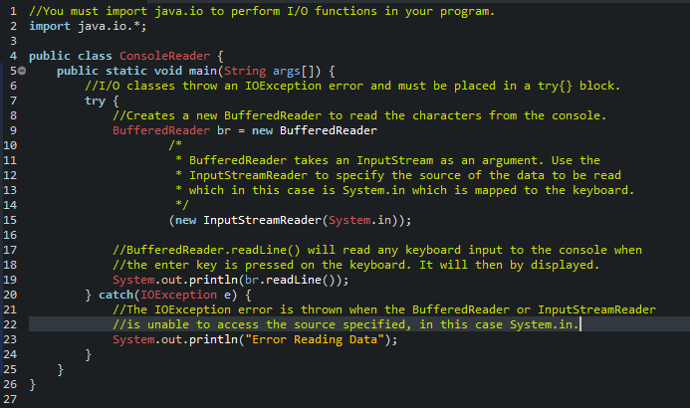
Reading Input From The Console

Slide 8
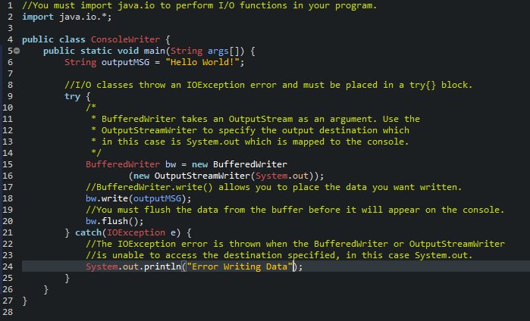
Outputting To The Console

Slide 9
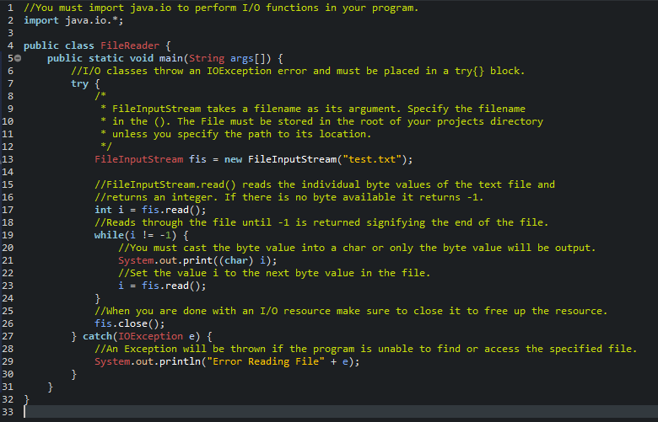
Reading From A File

Slide 10
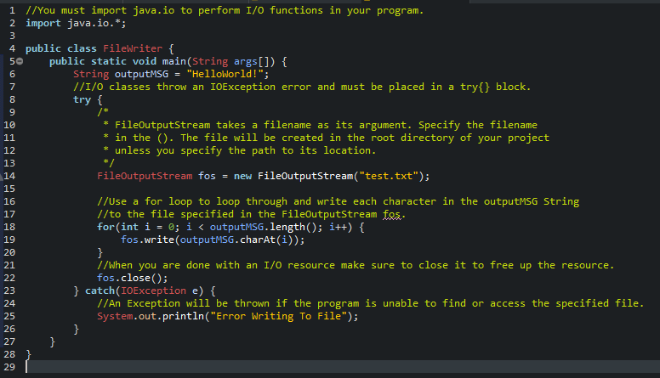
Writing To A File

